Slide 1
PLANNING OF METROPOLITAN CENTRES-Methodology for preparing Master Plan

Slide 2
Master Plan- Introduction
Master Plans prepared served-an instrument for ;
--Regulating physical development
- rationalizing land use pattern
- promoting orderly development
Better implementation of urban development programs
Master plans/ Development plans- synonymous- used interchangeably-having same meaning
Scope, procedure, objectives defined in legal framework
-called statutory instrument- meant to control, regulate, direct, promote, sound rational development /re-development of an urban area to achieve maximum- economic, social, economic benefits
Master Plan generally includes single unified landuse plan and regulatory guidelines to ensure orderly/planned development
-- having long term horizon of 20-25 years

Slide 3
Master Plan- Introduction
Master Plans;-Concept originated from British experience
- Third five year plan- post independence – recognized the need /importance of preparing master plans for urban areas
-Foundation of panned development laid- by Sir Patrick Geddes visit to India in 1915
-First master plan prepared for Delhi- 1961-82
Other cities followed Delhi Model
Master Plans prepared under State Town Planning Acts- land being state subject
- primarily allocates land for different uses- including residential, commercial, institutional, roads, highways, public purposes- based on defined norms and standards for the existing and future population
-- for promoting planned and orderly development of urban areas
-to ensure availability of all basic amenities and facilities to all the citizens including poorest of the poor
--

Slide 4
Defining Master Plan
A master plan is a;
-- dynamic
-- long-term planning document that
-- provides a conceptual layout
-- to guide future growth and development
-- of a Human settlement
Master Plan is a;
--Statutory instrument for
--controlling, directing , regulating and promoting
- the sound and rational development and/or
Re- development of an urban area
- with a view to achieving
maximum economic, social, environmental and aesthetic benefits
Master plan includes’
-- analysis,
-- recommendations, and proposals for the
-- settlement population, -- economy,
-- housing,-- transportation, environment, ecology
--community facilities, and
-- land use

Slide 5
Master Plan-Need
  Master plan -- an appropriate/ scientific tool for promoting systematic & planned growth of city
  For promoting, guiding and rationalizing-- future growth/ development of urban centers.
  Promoting planned development
  Endorsing growth in the desired direction,
  Quantifying the future population
  Quantifying the infrastructure requirement
  Estimating infrastructure investment
  --promoting economic development,
  -- improving service delivery
  Providing basic/essential amenities to people.

Slide 6
Master Plan- Objectives
  Promotes systematic & planned growth of city by:
  (i) Identifying existing gaps in physical/social infrastructure & to bridge those gaps
  (ii) Making assessment/suggesting strategies for economic development.
  (iii) Leveraging economy
  (iv) Rationalizing land use and their interrelationships
  (v) Minimizing haphazard and uncontrolled growth of town/cities
  (vi) Minimizing haphazard and uncontrolled growth of activities– commercial, industrial, residential etc
  Vii, Achieving planned growth/ development -- to provide healthy living environment
  (viii)Promoting better urban governance/resource generation.
  (ix) Rationalizing orderly movement of traffic/transportation
  (x) defining area for network of various services.

Slide 7
Master Plan- Objectives
  (xi) Indicating spatial distribution of physical/social infrastructure for optimum use
  (xii) Ensuring systematic, balanced/integrated development
  (xiii) Framing mechanism/strategies for resolving core area problems
  Xiv ) Identifying/preserving Heritage
  Xv) Ensure growth of cities take place according to prescribed norms and standards
  Xvi) Creating adequate housing stock and equitable spatial distribution of social and healthcare institutions
  Xvii)Eliminating slums and squatter settlements in the city
  xvii) Making informal sector integral part of urban planning
  Xviii) Making land market affordable, cost-effective and efficient
  Xix) Rationalizing landuse planning to minimize travel
  Xx) Controlling residential overcrowding by redefining densities and planning of housing
  Xxi) Providing land based solutions to rationalize traffic congestion
  XXII) Making cities compact
  Xxii) Promoting accessibility not mobility

Slide 8
Preparing Master Plan- Scope
Preparing Master Plan covers the following aspects:
Collection and review of available data, documents, reports, etc.
visiting city
Studying demand, supply and identifying gaps in service delivery. ,
identifying strengths, weaknesses, opportunities and threats,
preparing Existing Land use Plan, thematic maps,
• Reviewing ongoing / proposed development projects and other Govt schemes
• Formulating of vision and working out strategy
• Preparing of detailed Development Plan including approximate location and extent of land uses such as residential, industrial, commercial, etc.
Preparing Proposed Land use Plan and Zonal Development Plan etc.
Defining Development Control Regulations.
Evolving framework for implementation of the Master Plan/ Development Control Regulations •

Slide 9
Preparing Master Plan- Scope
Preparing Master Plan covers the following aspects:
Prioritizing projects and formulation of Investment Plan
• Formulating Investment Plan with appropriate financing strategies.
• Focusing on reforms to be carried out at the State/ District level in consonance to promote planned interventions
Master Plan can be prepared for ;
-- new town
--existing town
--Additional Area to be added/extension to any city
Master Plan comprises of –
-- A report detailing the -- study, analysis, finding and proposals and
Maps
--- Existing land use plan
--- Proposed Landuse Plan
--- plans depicting various studies carried out for city

Slide 10
APPROACH TO THE MASTER PLAN
Approach to the preparation of Master Plan would involve :
--outlining the critical issues of city development,
-- undertaking a demand-supply gap survey and analysis
Making Projections for the next two decades
-- formulating management framework including /strategies for future growth and development to include :
Defining options for promoting rational development
--through the introduction of a regulatory mechanism
--realistic planning and
-- management interventions
--within overall regulatory and institutional framework.

Slide 11
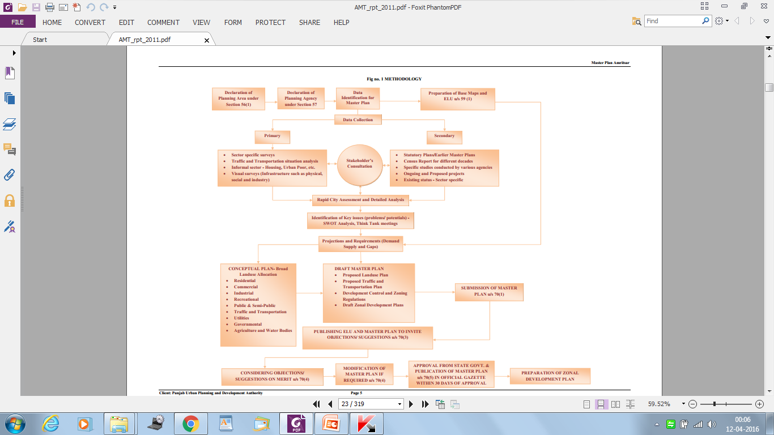
PREPARING MASTER PLAN

Slide 12
METHODOLGY FOR MASTER PLAN
Various stages of preparation of Master Plan include:
1Taking an administrative decision regarding preparing master plan of any settlement
2. Identifying ,defining ,notification of Local Planning Area
3 Identification and notification of Planning Agency
4.- defining procedure, aims, objectives, stages, legal requirements of master plan
. 5,Preparation of Existing Land Use Plan- ----
--Satellite Imageries,
--Survey of India maps
--Physical Ground Surveys
--Revenue maps
-- other available documents
- Ground truthing
·

Slide 13
METHODOLGY FOR MASTER PLAN
· 6 Study, assessment and analysis of Local Planning Area/urban areas in terms of--
· Regional Setting
· Historical Evolution
· Demographic Studies
· Socio-Economic Studies
Housing
Slums & Poverty
Trade and commerce
Industries
· Traffic & Transportation
· Physical Infrastructure (Water Supply, Sewerage, Solid Waste Management, electricity, roads etc
· Social Infrastructure (Educational, Medical, Recreational, Miscellaneous)
Environment , Heritage and Tourism
· Growth Pattern
· Land use
· Available studies and report
· Ongoing and Proposed Projects

Slide 14
METHODOLGY FOR MASTER PLAN
7. Involving Stakeholders--- through:
FGD’s and personal interviews
· Meeting with experts
· Think Tank meetings
· NGOs/ Private agencies/ Public Agencies/state Departments
· Public Representatives,
Conducting surveys
8. Identifying Gaps , Issues and Problems of services, infrastructure, amenities, congestion, housing, pollution, traffic and transportation social, economical, physical, environmental etc through
– based on existing population-
-- Comparison with available norms and standards
-- Spatial Distribution
-- Quantitative and Qualitative analysis

Slide 15
METHODOLGY FOR MASTER PLAN
9. Carrying S.W.O.T analysis based upon--
• Studies made and analysis carried out
Focused group discussions
Discussions in think tank
Discussions with experts
Discussions with officials working at local level
• City Assessment
Surveys carried out
• Stakeholders/NGOs’ Perception
• Identified problems and gaps
• Identified major socio-economic drivers

Slide 16
METHODOLGY FOR MASTER PLAN
10 Defining a vision for city- based on SWOT analysis and
11. Missions to achieve the Vision
12. Working out population for next 20 years – in a slab of 5 years
13 Working out City requirements- for next 20 Years based on:
--Population Projections made,
--Norms and Standard prescribed
-- Broad Land use Requirements for different uses
-- Existing gaps already identified
- Additional land requirement for population projected to be added
14 Carrying out land suitability analysis of the planning area
15. Defining Conceptual Framework through:
-- Defined Vision for future growth and development
-- Identified broad objectives
-- Laid down mission statements for critical areas
--- Working out traffic and transportation network
- Land suitability analysis carriedout

Slide 17
METHODOLGY FOR MASTER PLAN
- identifying areas to be;
-- preserved
- conserved
- heritage area- manmade and natural
-- eco-sensitive areas- forest area/ watershed/ reserve park
- area prone to flooding/disasters- low lying area
-area fit for development
- area under statutory restrictions
- used for defence
- area unfit for urbanization
- area fit for urbanization
- land suitability for different uses- residential, commercial, industrial, institutional, wholesale trade etc
-- Existing/proposed road network
16. Preparation of alternatives--Concept Plans

Slide 18
METHODOLGY FOR MASTER PLAN
17. Evolving Draft Master Plan – Involving Proposed Land Use Plan /Traffic & Transportation Plan along with Development Control Regulations (D.C.R)
- Based on existing land use plan
- critical areas,
- growth drivers
- areas to be preserved, conserved and promoted, heritage areas
-- land use analysis, land suitability analysis etc
-- Studies and assessment made
--- Gaps and problems identified
· Stakeholders’ perception
---Objectives/ vision/ Mission framed
· Future population growth
---- Future infrastructure requirement
-- Available land for development

Slide 19
METHODOLGY FOR MASTER PLAN
18.Approval of draft master plan-- from competent authority and state government
19 Notification of Draft Master Plan for Inviting Public / parastatal agencies --Objections/ Suggestions
20 Considering Public Objections/Suggestions
21 Amending draft master plans based on;
-- suggestions made and-- objections received
22. Approval of amended draft master plan from Master Plan- from competent authority and state government
23 Notification of approved Master Plan-
24 Evolving Zonal Plans based on Proposed Land Use
25 Implementation of the Master plan
26 Revision of the Master Plan after every 10 years
27 New Master Plan to be prepared after20 years of framing

Slide 20
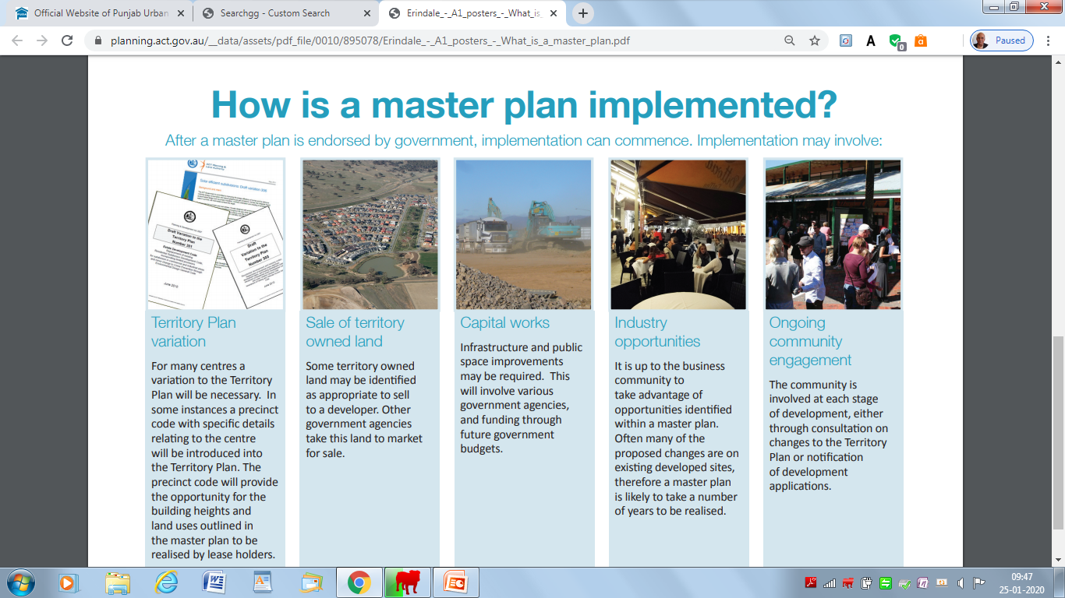

Slide 21
MASTER PLANS - Limitations
Lengthy, cumbersome time consuming process--Requires lot of time/resources- manpower
Requires large financial allocation
Rigid- lacks flexibility
Based on only physical aspect--defining land use mechanism
-sometimes ignores large social, economic, environmental issues
emphasizes plan preparation
Lack of availability of city centric accurate data
Prepared mostly using secondary data; Only few surveys are done
Absence of stakeholders participation
Lack of transparency
Lack of trained manpower/ technology
Inaccurate base plan/ existing land use plan
Mismatch between plan proposals and ground realities

Slide 22
MASTER PLANS - Limitations
Large number of disputes in plan interpretation
Lack of involvement of specialized agencies/expertise
Plan preparation and plan implementation divorced
Freezes city/ Land use for 20 long years
Unable to meet emerging urban challenges
Unable to address urban dynamism
Emerged as major road block in planned development
Leads to emergence of Slums/ haphazard development
Does not address needs of the informal sector
--document of exclusion
--Emerged as elitist in nature
--Major source of corruption/ manipulation

Slide 23
CHANGING CONTEXT OF MASTER PLANS
Need to make Master Plan a better Master Plan by:
-- changing its intent, content, approach and philosophy
-- making it people/city centric
-- involving participatory approach
-- bringing flexibility
-- preparing it in a short time,
--structure defined through
-- road network,
--infrastructure network and
---detailed planning / development guidelines

Slide 24
CHANGING CONTEXT OF MASTER PLANS
Master Plan to be promoter of Planned development rather than controller of development
Master plan to make city compact
Plans prepared with energy efficiency as focus
To reduce carbon footprints of city
Promoting mixed rather than pure land use planning
Promoting Green Transportation-- pedestrianisation, cycling, public transport as the-- preferred mode of transportation
Promoting transit oriented development (TOD) to minimise travel--Minimising use of Agricultural land
minimum land under urbanization-Promote 24x7 use of land--

Slide 25
CHANGING CONTEXT OF MASTER PLANS
Promoting self-sufficiency in day to day needs
Promoting Decentralization
Providing open spaces on defined norms
Planning city on well defined norms and planning parameters--Planning for people rather than vehicle
Planning for accessibility rather than mobility
Promoting water sufficiency
Promoting-- reduce, recycle and reuse in city
Making informal sector integral part of planning process
Promoting Green Energy in city- Solar, Wind, Bio-mass, Geo-thermal energy
Preparing Master Plan using nature as the basis- SUN, SPACE, VERDURE

Slide 26
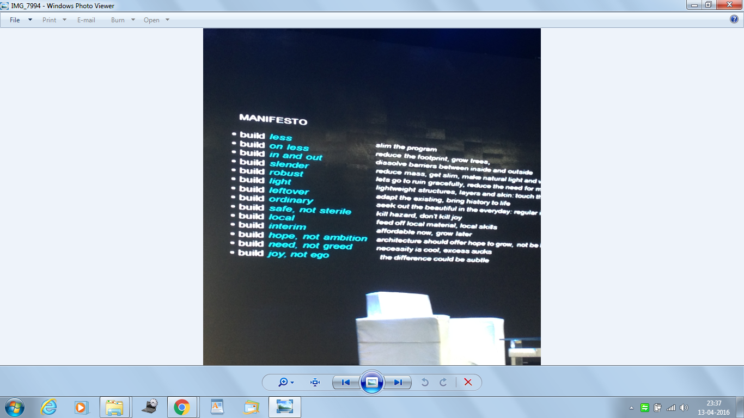

Slide 27


