Slide 1
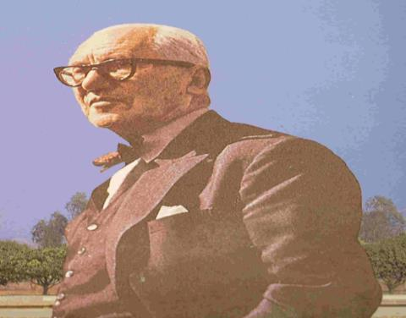
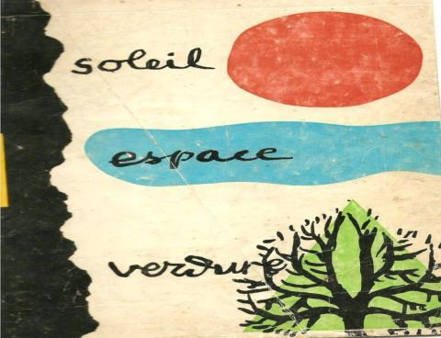
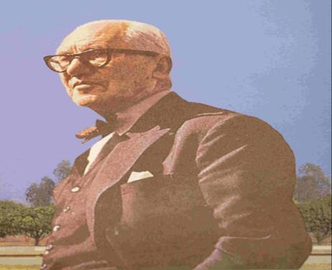
MAKING AND UNMAKING OF CHANDIGARH- A CITY OF TWO PLANS
J.K.GUPTA, former Advisor( Town Planning) , PUDA
jit.kumar1944@gmail.com

Slide 2
Cities and their Context
Cities have been part of human history.
Cities- known to command power and authority
Cities -- known for their dualities and contradictions.
Cities- known for both -- positivity and negativities
Cities -- known to be areas of concentration of population/ activities, infrastructures, services, healthcare, education
Cities -- known to be Engines of economic growth-70%
Cities - generators of employment , wealth and prosperity,
Cities – also known for their negativities,
where rich and poor rub shoulders-
Cities – large consumers of resources/energy/ land
Cities-– consuming 60% global energy
generating 70% of carbon footprints
- largely responsible for global warming-

Slide 3
Cities and their Context
Cities- remain a manmade , mechanical environment
Cities- destroy natural habitat-anti-thesis to bio-diversity
Cities- known to be creator of best/ worst living conditions- housing both rich and poor
Cities- home to large migrants
Cities- home to slums
Cities- remain in crisis- natural and manmade
Crisis of population, poverty, pollution
Cities – ever evolving and devolving
Cities – were, are and shall remain dominant in future
Cities- drivers of nation’s future
However Cities need rationalization
Made more-- bio-diverse; productive, effective, efficient, humane, livable, sustainable, Healthy place to live /work

Slide 4
Chandigarh
Chandigarh remains a city of crisis
Chandigarh is not a planned city but a designed city
Chandigarh -- known for its numerous distinctions;
-Offering basic amenities of life to poorest of poor- dignified life
-- selecting most appropriate site for locating capital city
-Orderly planning, development /management
- Efficacy of Grid Iron Pattern
- Pure land use planning
- Sector- as unit of neighborhood planning
- Giving a concept of 10 minute city
- Urban planning catering to 4 basic human functions
- Known for planning with nature- Sun, Space and Greenery
-Known for Rule of 7V’s- 8bc- for traffic planning
--Known for impacting cooking/living habits

Slide 5
Chandigarh
-Known for development Controls- both within/outside city
Known for peri- urban development / regional planning
-Making landscaping integral part of city planning
- Known for giving concept of bulk acquisition of land
- Known for developing a planned city without a master plan
- known for concept of free-hold/lease hold property
- Giving a new vocabulary to architecture and planning
- Establishing credibility of planners/ architects
- Using principles of CIAM in Urban planning
Proved efficacy of Bureaucratic model of urban governance
- providing concept of re-densification of city
- First city without statues /roads named after individuals
- Creating an artificial lake as part of city planning.
-First city to achieve planned population- within 4 decades

Slide 6
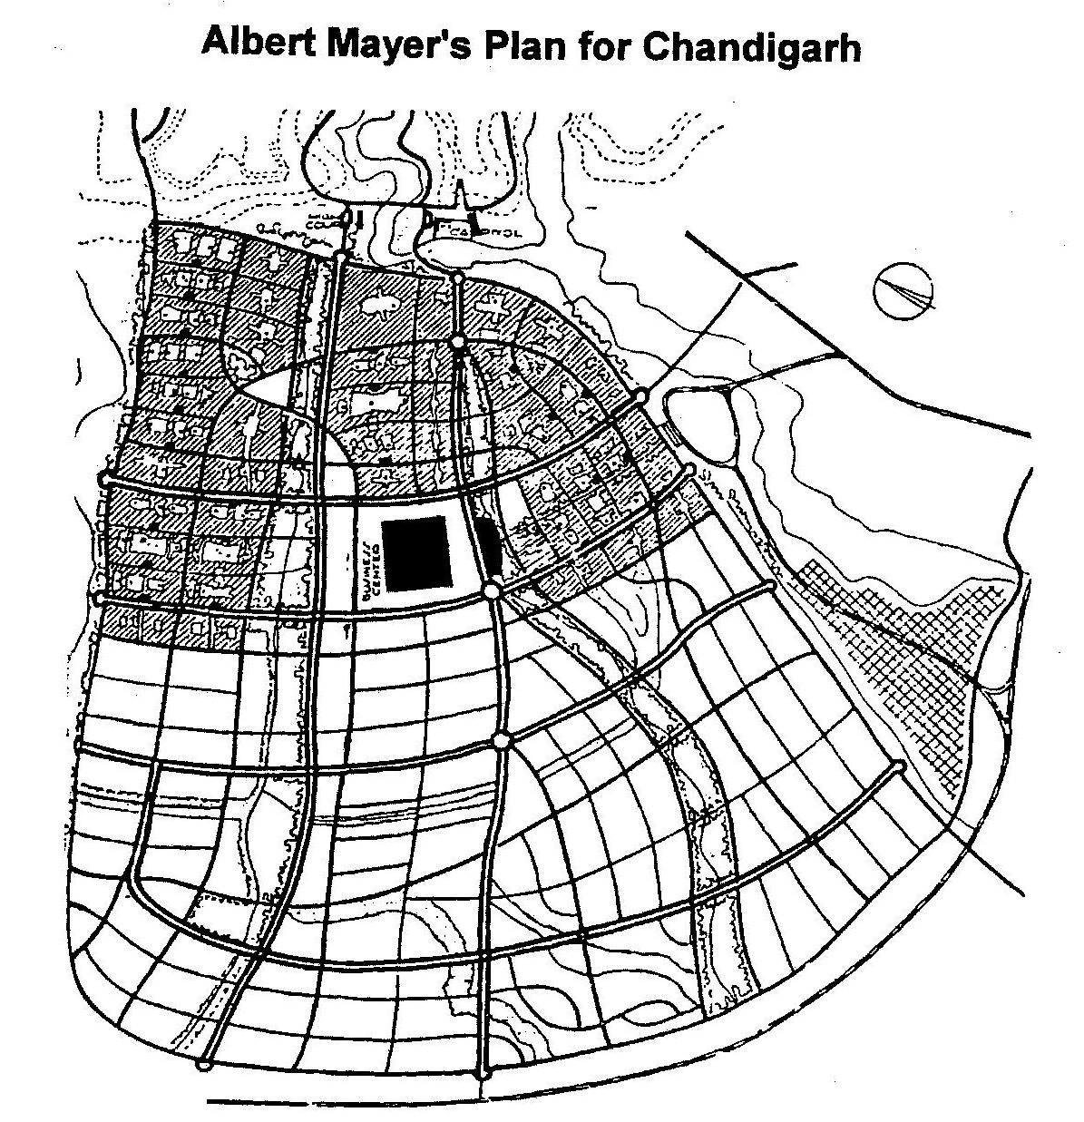
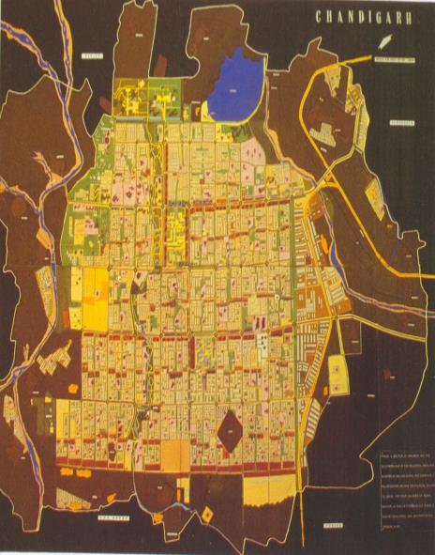
Historical Perspective

Slide 7
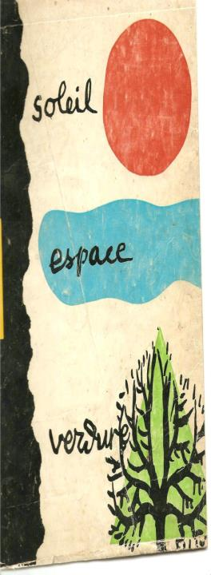
Birth of An Idea
Lahore- capital of Punjab lost to Pakistan during Partition of India- 1947
Building new capital for East Punjab -- a necessity
Building a capital conceived in 1947.
locating capital in existing towns overruled for reasons of;
Security, Centrality, accessibility, infrastructure, Development & Ambiance of capital
The capital city was supposed to:
  Rehabilitate the state governance
  Rehabilitate refugees
  Recreate rich legacy of Lahore
  Creating a symbol / spirit / potential of independent India
  Establish a city with a vision of future-unfettered by traditions of the past.

Slide 8
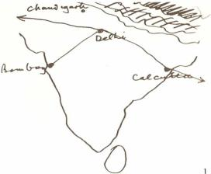
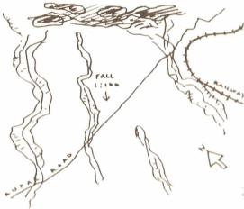
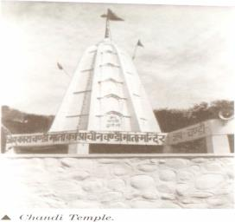
Locating Chandigarh
For Selecting site
-- State Government appointed a committee.
Team zeroed on site in 1948,
-- located in sub- mountanus region,
- in District of Ambala
- in the shadow of Shivalik Range of Hills
--260 kms North of Delhi due to;
  Centrality in state --
  Proximity- to National Capital.
  Accessibility- both by road/railways
  Availability of Sufficient water.
  Gentle gradient- for natural drainage.
  Absence of physical encumbrances
  mango groves/ temples marked site.

Slide 9
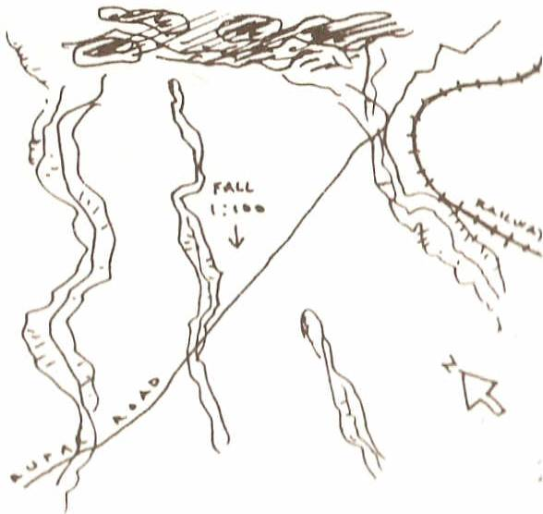

Slide 10


Slide 11
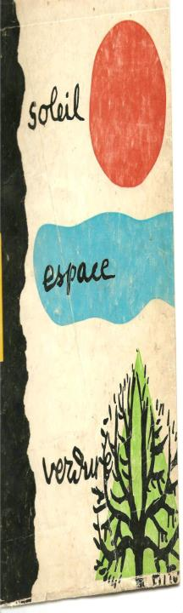
Architects Brief
City -- planned for 0.5 million.
Chandigarh-- to set an example in providing:
- Quality Urban planning& Development
- generous infrastructure both hard/soft &
-- Best of support services,
--Chandigarh - to be first Indian city where
basic services including;
water, sanitation
drainage, electricity,
roads, healthcare; shelter, education
would be available even to “poorest of the poor” to lead a dignified life
Vision -- a capital;-- that would serve as a role model for nation in art & science of;
city planning
architecture

Slide 12
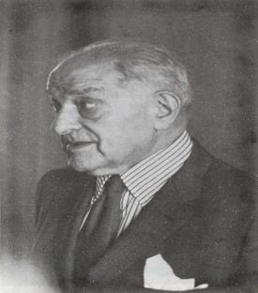
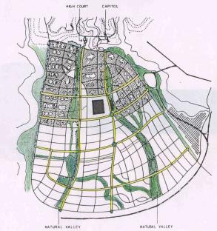
Designing Chandigarh by Albert Mayer
Near vacuum of local expertise made state to seek best of western skill to realize dream of creating a beautiful city.
Considering
-- financial / other constraints and
-- defined goals,
- search was narrowed down to a good modern architect :
  capable of developing new concept
  suited to Indian climate,
  using available materials and
  Meeting functions of new capital.
Task assigned ;
-- American Planner Albert Mayer
--& associate Mathew Nowicki

Slide 13
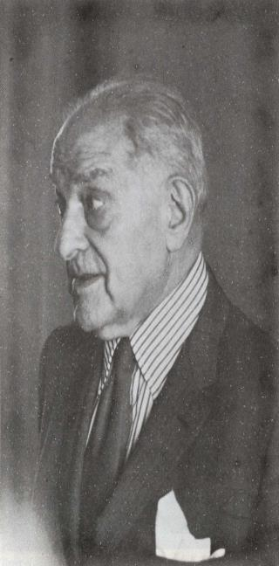
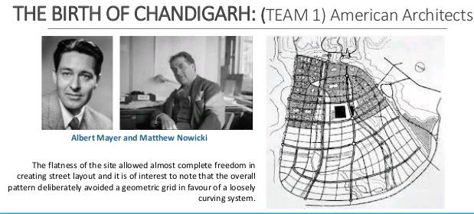
First Master Plan- Albert Mayer

Slide 14


Designing Chandigarh by Albert Mayer
Mayer defined Chandigarh in terms of:
  Fan shaped city.
  Curved and radial network of roads.
  A network of parkways.
  Super block as basic unit of residential planning
first master plan decided
  Placing of Four major components of city including
    Capitol,
    University,
    City Center,
    Industrial Area,
  Capital occupying most prominent position
  City center - center of the city
  industrial area – South East position
  University- - North West position
Neighborhood unit/ Super block- used in number of American projects -Baldwin Hills (1941) by Clarence Stein.

Slide 15

First Master Plan- Albert Mayer

Slide 16
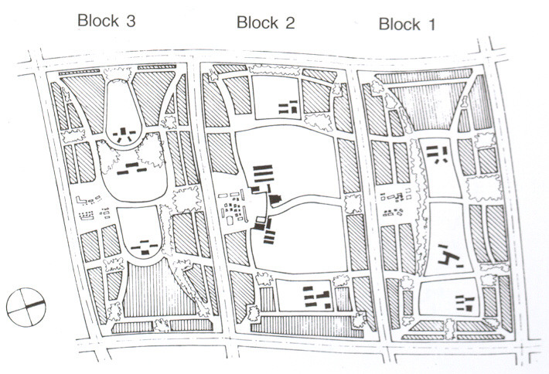
ALBERT MAYER’S SUPER BLOCK
Super block measured 500 m x 1000 m in dimension
Each super block consisted of three parts which contained
housing, schools, shopping centers, others amenities.
3 types of housing – Low, Middle and High income groups were inter-mixed.

Slide 17
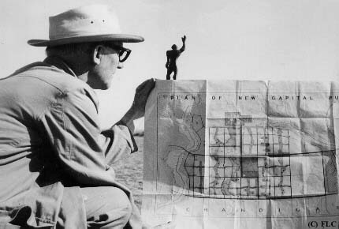
Team – 2-- LE CORBUSIER WITH BLUE PRINT OF MASTER PLAN OF CHANDIGARH

Slide 18
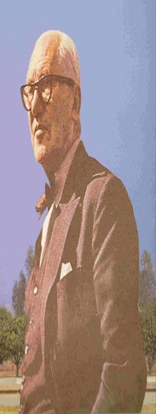
Re-designing Chandigarh by Le-Corbusier
Sudden death of Nowicki -in air crash in August 1950- changed the destiny of Chandigarh.
State Govt. approached Corbusier for completing city.
Corbusier wrote in preparation of his first meeting with Mr. Thapar & Verma:
  It is the hour that I have been waiting for:
  India the humane and profound civilization.
  To construct a Capital.
  Urbanism is the activity of a society
  A capital is the spirit of a nation
  A set of tools
  It is a conjunction ….Le Corbusier is an optimist.
  His name is not mentioned but in 20 years of urbanism. L-C is in all the projects.
It was indeed the hour Corbu waited for 24 years of frustrated efforts/ collapsed hopes
  From debacle of the Palace of the League of Nations competition in 1927
  To his exclusion from final design United Nations Head Quarters in 1947
  With shelved Master Plans for half a dozen cities
  sudden arrival in summer of 1950 of two men from India was the climax of Le Corbusier’s career.

Slide 19
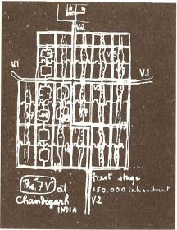
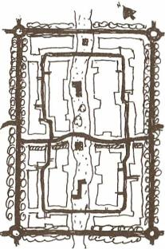
Re-planning Chandigarh by Le-Corbusier
In India Corbu was able to realize three of his continuing pre-occupations
  the city,
  the govt. complex and
  the cultural complex
  and had Museum of Knowledge been built in Capitol, he would have achieved his desire for fusion of the last two.
Le-Corbusier appointed Architectural Advisor (two yearly visit of one month each) with Pierre Jeanerette, Maxwell Fry and Jane B Drew as members of the team.
All four were members of the CIAM-The Congress Internationaux d’ Architecture Moderane-the ideology which played key role in designing the new city.

Slide 20

Re-planning Chandigarh by Le-Corbusier
Agreement with second team included
  acceptance of Mayer’s Plan,
  designing capitol complex including buildings,
  Museum and
  implementing master plan
Corbusier had other ideas, told Fry and Drew:
  We will rectify Master Plan .
  We must make a new beginning.
In four days in February 1951 in Chandi Mandir, he redesigned the city.
There was just sufficient overlap between the two master plan for Mayer to sign the new one as co-author.
The master plan of Chandigarh belongs to
  high tradition of modern architecture
  represented by principles of CIAM.

Slide 21
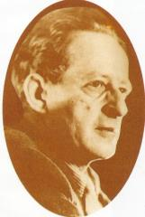
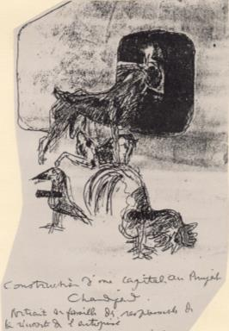
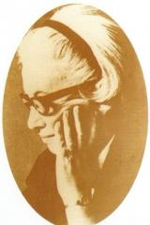
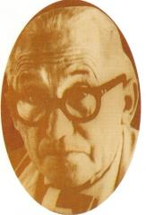
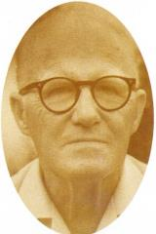
LE CORBUSIER’S TEAM
DRAWING AND INSCRIPTION BY LE CORBUSIER
E(dwin) Maxwell Fry
JANE B(everly) DREW
French Original
Construction d’ une capitale au Punjab Chandigarh
Portrait de famille des responsables de la reussite de l’ entreprise.
English Rendering
Construction of a capital in Punjab-Chandigarh.
Portrait of the Family which is responsible for the success of this undertaking
LE CORBUSIER
PIERRE JEANNERET

Slide 22

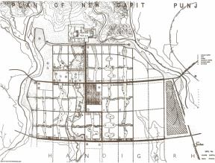

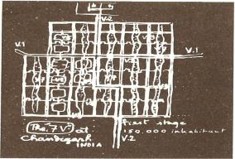
COLONIAL ARCHITECTURE
LE CORBUSIER’S MASTER PLAN – DESIGN APPROACH
VICTORIA HALL KOLKATA
Critical factors impacting architecture and urban form of Chandigarh were:
  Low budget for city($2.2m)
  Existence of plan prepared by Albert Mayer
  Strict adherence to budget /pre-conceived structure
  Value estimates prepared on Mayer’s Plan
  Large range of social services to be provided
Which made Chandigarh
  A low density and
  A low rise city with
  Simple traffic system and
  sector layouts dictated by restricting cost of roads, service & infrastructures.
Consideration of economy also dictated.
  choice of local bricks-- chief material for construction
  boulders/pebbles from nearby rivers beds used in random patterns creating a rich variety of surface texture.

Slide 23
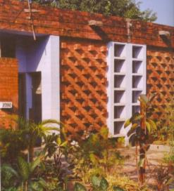

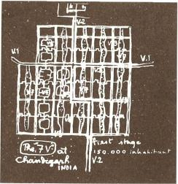
COLONIAL ARCHITECTURE
LE CORBUSIER’S – DESIGN APPROACH
  Minimizing windows- sizes/glass-cost of wood work/glazing 7/ 11 times more than a brick wall.
  Standardizing- doors, window, sanitary fittings, ironmongery and
  Using pre-cast --roof battens to save on time / labour during construction.
  using manpower --not machinery for achieving economy.
  Chandigarh Architecture became product of:
  Protection from sun/ dust laden winds of hot seasons
  discipline of cost, material, technology, climate
  created a box-like structures of bricks/ stone
  small windows protected by brise-soleil, jalis
  Which led to beginning of a style
  which Architects had not consciously sought
  but became hallmark of Chandigarh architecture
  -Despite constraints, Corbusier promised a unique life to future inhabitants of the new citycity.
VICTORIA HALL KOLKATA

Slide 24

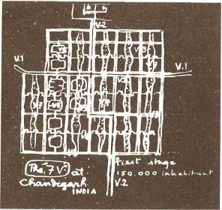
LE CORBUSIER’S MASTER PLAN
The city plan based on four basic functions
Living
Working
Care of Body & Spirit-COBS
Circulation -
- Re-siting Capitol
- Reduced area to be acquired for the city,
Mayer's fan shaped city with curved network of roads, changed – adopting grid iron pattern of straight roads because:
- Circulation of traffic demands a straight line
  -The curve is ruinous, difficult and dangerous;
  -it is a paralyzing thing.
  -The straight line enters into all human history,
  -into all human aims,
  -into every human act.
Present urban form of Chandigarh is derived from:
  -Grid iron pattern with straight roads
  -Neighborhood units-sector.
  - circulation pattern based on 7vs (les sept voies)
  - grid of fast traffic with V3 roads defining edges

Slide 25
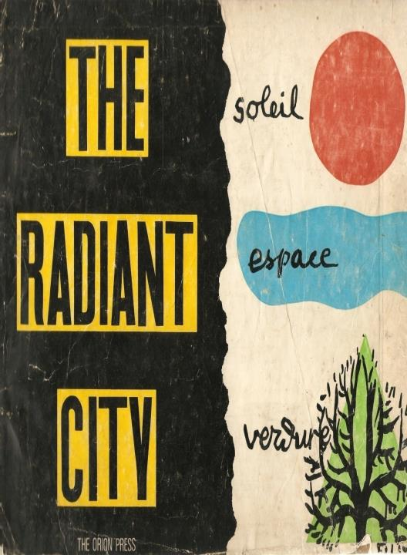
The Radiant City
  An organism capable of housing the works of man of machine-age society.
  placed under the masterful government of natural conditions:
    Sun
    Space
    Greenery
  And its mission is the service of mankind:
    To live
    To work
    To cultivate body and spirit
    To travel about
    (in this order and obeying this hierarchy)

Slide 26
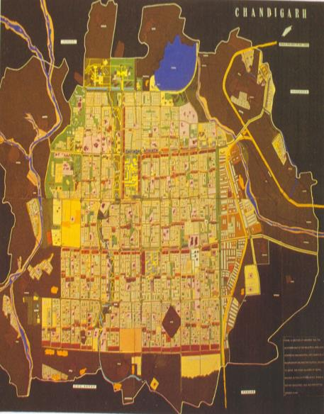
City planned for a population of 0.5 million to be realized in 2 stages.
Stage-I (S1)
Sector 1 to 30-- covering 3642 hectares for 150000 population a low density development of 41.12 persons per hectare(16ppa)with high order of infrastructure / amenities. Land to be allotted on free hold basis.
Stage-II (S2)
Sector 31 to 47- covering 2428 hectares
for 350000 population, a high density development of 144.15 persons per hectare(56ppa) (3.5 times of stage 1). Land to be allotted on lease hold.
Stage-III (S3 )
Re-densification of Stage-I -- to accommodate population exceeding 0.5 million without compromising with quality of life.
COLONIAL ARCHITECTURE
VICTORIA HALL KOLKATA
S1&S3
S2

Slide 27
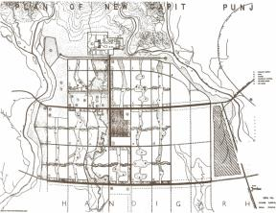


LE CORBUSIER’S MASTER PLAN
Density of the sectors rising from north to south
  as social class of inhabitant becomes lower,
  city became a social map .
  Arrangement explained by Verma ;
    Le Corbusier wanted transition to more openness towards capitol and
    drainage system being more rational due to natural fall south-wards.
  Dry bed of subsidiary monsoon water-course made leisure valley meandering through town.
Jane Drew called Master Plan-- a poetic significance, biological in context ,with
  Commanding head - Capitol
  Its heart -- commercial City Centre
  Its hand of productivity - Industrial area.
  Its hand of learning - University.
  Its brain and intellectual centers in Parkways where are located museums, library etc.
  Roads as Arteries - carriers of Blood in shape of Traffic with
  Glass and Bricks as –Skin of the city/buildings

Slide 28
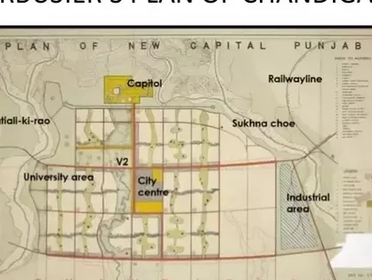

Slide 29
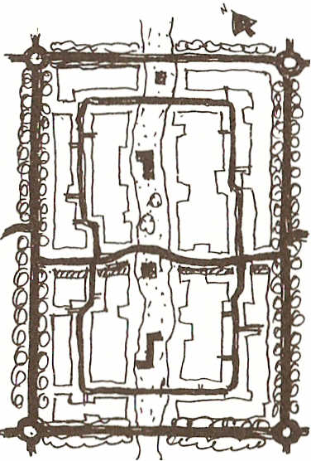
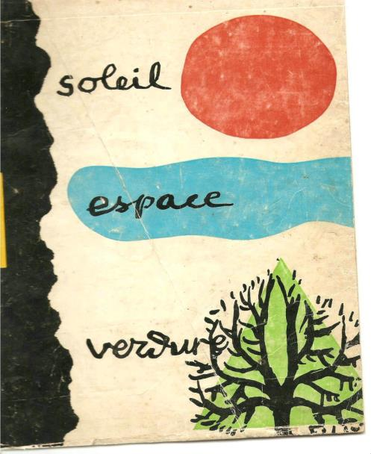
Living-SECTOR Defined

Slide 30
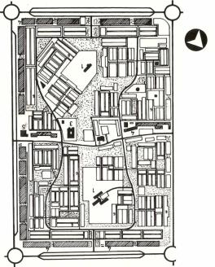
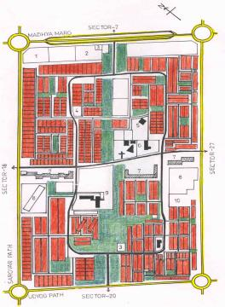
Sector Defined
Sector-Container of basic human needs of:
Living
Working
Care of Body and Spirits (COBS).
Population varying between 5000-25000
Size 800mx1200m- based on human scale/ walkability to reach any activity/corner
Sector planning based on principles of:
  Creating city within a city
  Using human scale- walkability
  Making Sector a 10 minutes city
  Self-contained / Self-sufficient Neighborhood unit.
  Safety from traffic- connecting man with nature
  Introvert in character-Zanana city- Charles Correa
  no house opening on fast carrier of traffic
  bounded by fast traffic roads running on all sides.
  With four entries, one from each side.

Slide 31
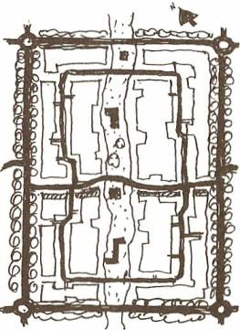
Sector Defined
  For linking with Greater Himalayas- a continuous green belt stretching North-East to South-West provided in centre of Sector.
  Green belt to house Education, Cultural, Religious and Community Buildings.
  All houses provided with- setbacks(open area) in front and rear.
  Though buildings of different Sectors varied but sectors follow same planning principles.
  Each Sector has a central green bisected by shopping street (V4).
  A loop road distributes the traffic in interior (V5) intersecting shopping street.
  Individual houses derive approach from roads- V6 -branching out of loop road.
  Grouping of houses /density pattern derived on basis of income.
  High income Sectors have low density and a pattern of detached houses.

Slide 32
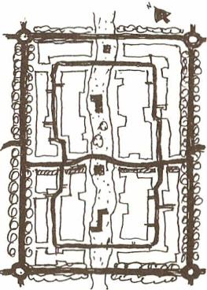

Sector Defined
For achieving higher densities, LIG Houses provided with terrace housing/built up houses on smaller plots.
  Sectors 7 & 8 are exception, planned on Mayer’s concept of Super Blocks.
  Centre of focus -- V4 shopping street,
V4-a curved road to slow down traffic with shops on one side (South-West) and verandah to provide shade to shoppers protection from sun/rain and to eliminate crossing of streets.
  Market linked with adjoining Sectors, forming a continuous ribbon.
  Variety of shops provided- from smaller booths to larger Shop-Cum-. flats
  Larger shops designed as three storyed buildings with shops on ground floor and residence for owners on upper floors,
Safe from traffic and in close proximity to the nature, sector constituted an attempt to create city within a city which provides for all the basic day to day material and social needs of the citizens in easy reach of the home, but at the same time linked to the larger scale of the city in terms of transport and services as well as architectural meaning.

Slide 33
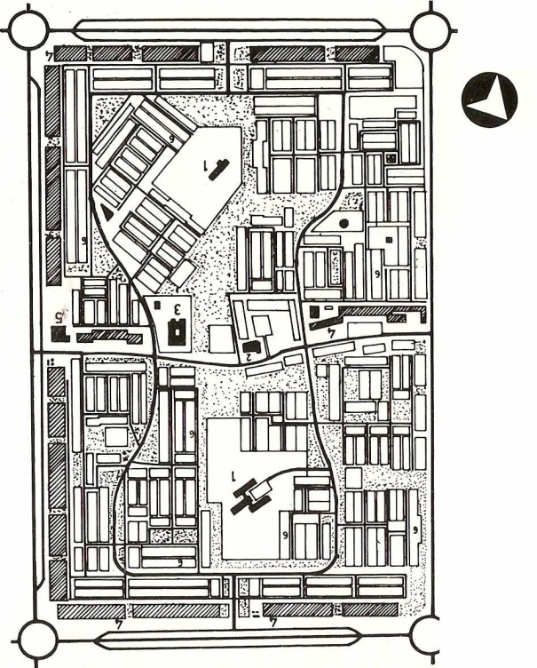
SECTOR -22
First Sector planned by Jane Drew

Slide 34

LIVING-
HOUSING

Slide 35
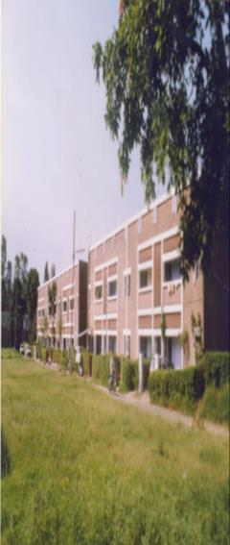
Housing
The focus of housing was:
  Oxonian program comprised 13 categories of government housing
  Type 1 for Chief Minister to Type 13 for peons.
  Type 14 with minimum accommodation designed for poor- 2 rooms, a space for kitchen, bathroom and rear open space
  Three lowest categories of government housing subsidized to maintain minimum standards of amenities.
  Economy, Technology and Climate governed design /construction of houses.
  Architects bound to follow state directives regarding cost /type of accommodation.
  Type 7 designed as semi-detached
  --higher types fully detached with
  -- lower categories designed as terraced housing.

Slide 36
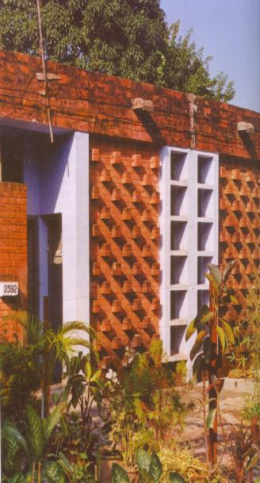
GOVERNMENT HOUSING
Credit for designing Govt. housing goes to Pierre Jeanerette , Maxwell Fry and Jane Drew.
Pierre Jeanerette designed all 13 categories of government housing except type 3, 7 and 8.
House types named after the initials of the Architects. For example: 12F, 6J etc.
Indigenous devices - sun-breakers and jalis diffused heat and provide sunlight , air.
Verandahs, courtyards and terraces for sleeping outside- included in most house types.
Locally made bricks used for load-bearing walls, parapets and sun-breakers.
The houses built mostly single-storyed or double-storyed.
Size of fenestration kept minimal to reduce cost
Number of innovations used to minimize cost / time for construction using pre-cast elements
HOUSE TYPE 11-JC, CHANDIGARH

Slide 37
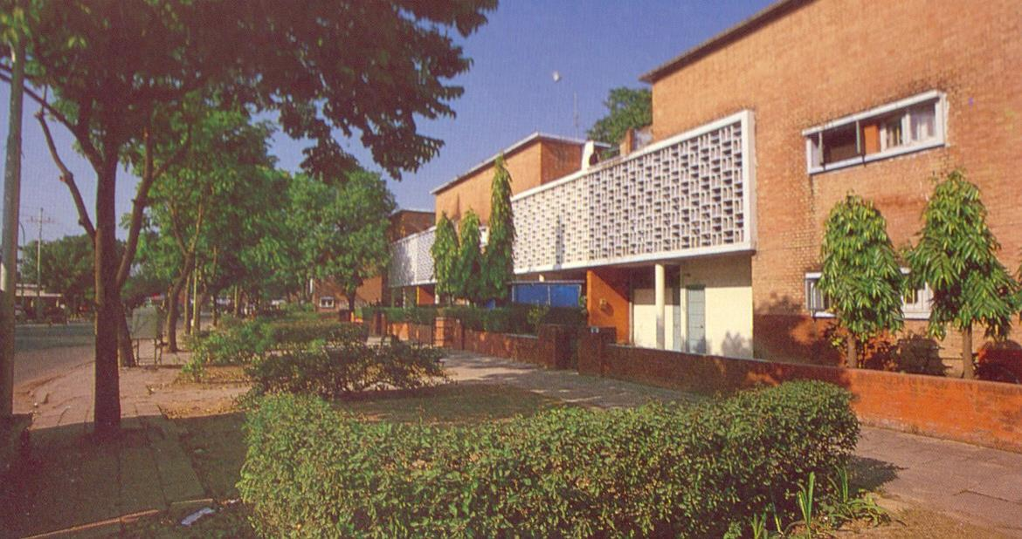

Slide 38


Slide 39
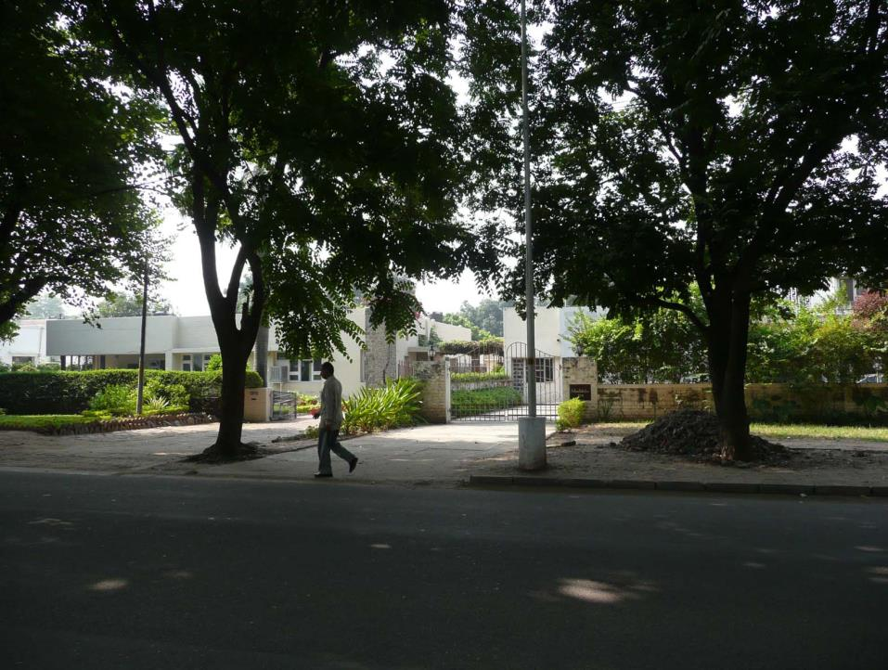
Le Corbusier, Croquis du complexe du Capitol, 12 avril 1952

Slide 40
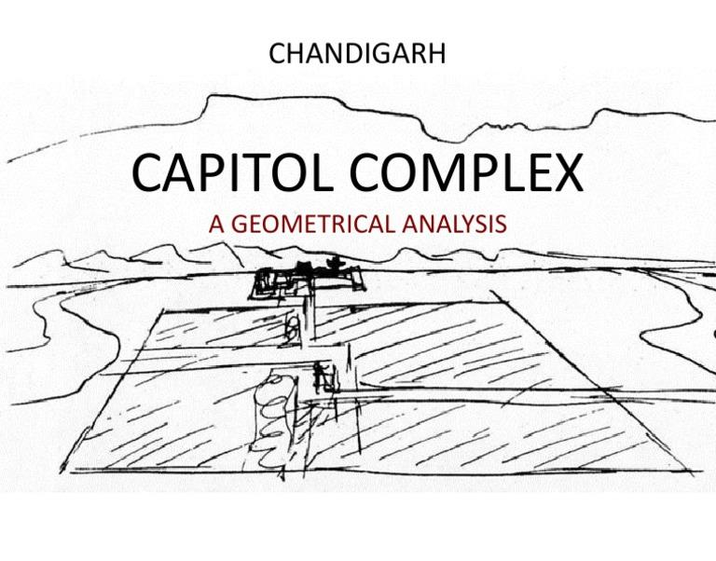
Working-
Capitol

Slide 41
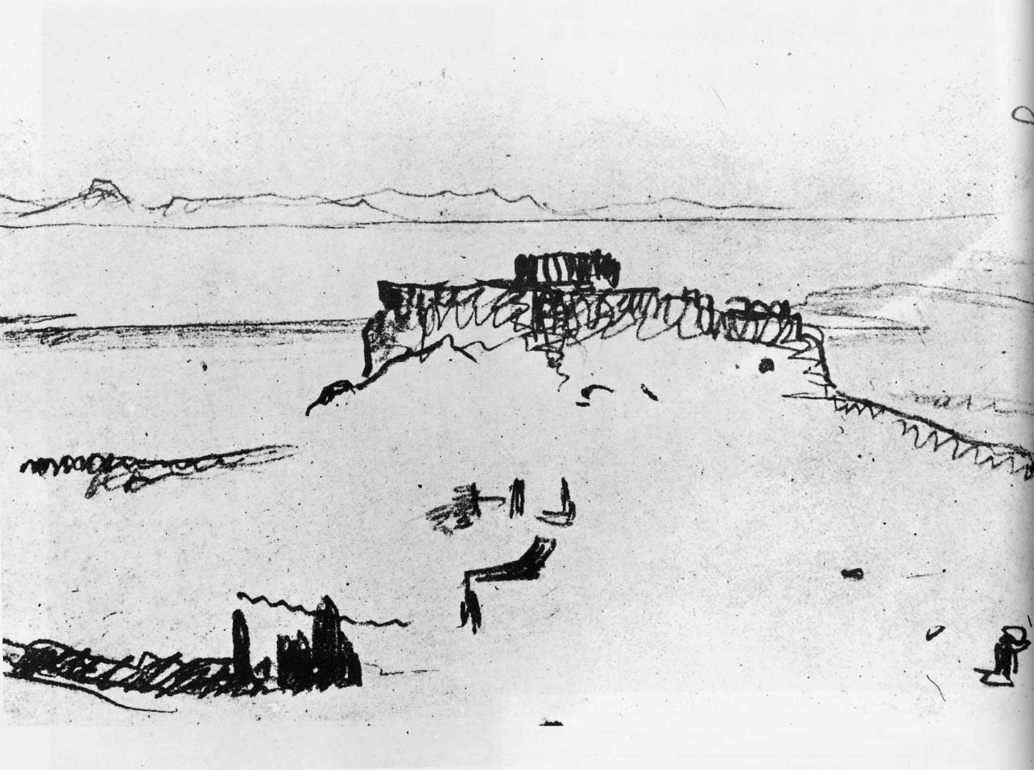
Acropole d’Athènes, Le Corbusier

Slide 42
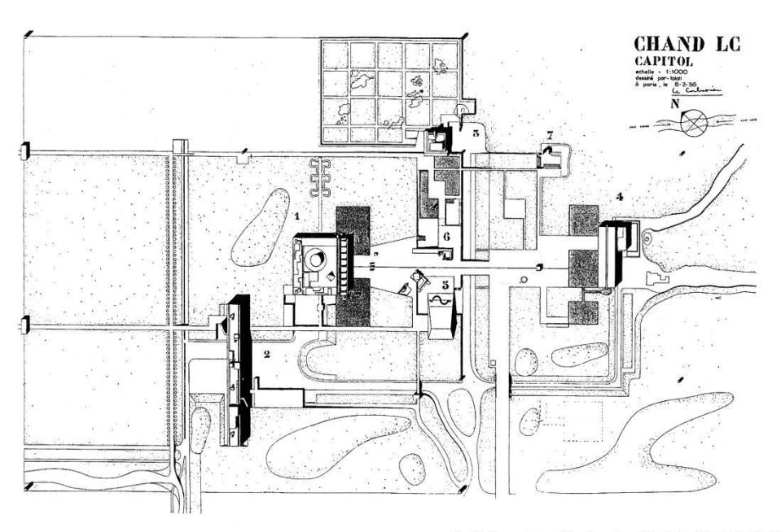
CAPITOL COMPLEX-CHANDIGARH

Slide 43
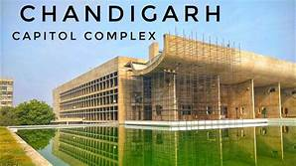
CAPITOL
City’s Focal Point - an admirable Park, Mountains, Trees, Flowers Architecture.
Its Architecture- most representative of Le Corbusier ’s work.
Spread over100 hectares.
master plan asymmetrical consists of ;
--four buildings
-- six monuments
--arranged in three interlocking squares.
- Only three buildings realized- High Court, Legislative Assembly& Secretariat)
- -- designed to represent 3 pillars of democracy-Governor’s Palace, never built
--Replaced by Museum of knowledge
Secretariat -a long, horizontal concrete slab form, -- western edge, high court –Eastern edge -open hand crowning glory
Chandigarh’s Capitol Complex-- on Sunday, July 16,2016- declared by UNESCO as World Heritage
-- at the 40th session of World Heritage Conference in Istanbul, Turkey.

Slide 44
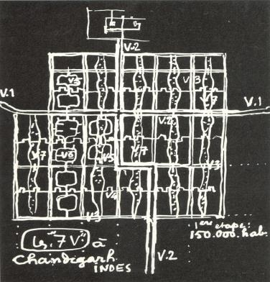

Capitol
Planned and developed to be pedestrian,
man master of himself,
on his own feet, walking / living free of fear,
automobiles prohibited in park.
Clear segregation of pedestrian/ vehicular movements with land arranged on two levels:
  a pedestrian plateau and
  5 meters below -roads and parking.
Length of esplanade between High Court & Assembly
- distance from Hayward Gallery to Country Hall on London’s South Bank (450 mt).

Slide 45

Secretariat
-- largest in Capitol Complex
Houses both state Govts.- Haryana / Punjab.
- long / horizontal rough concrete structure
254 meters (833 feet) long, 24 meters wide, and 42 meters (138 feet) high.
Defines western edge of Capitol Complex
-- building consists of eight floors
- with 6 blocks separated by expansion joints.
-Building bears close resemblance to Marseilles apartment
structure exteriors defined by exposed concrete ramps and small square windows.
building designed to manage sun
Green Roof minimizing heat transfer
-Positioned North- South, with central corridor
Minimising maintenance /promoting sustainability-enhances splendor of Capitol Complex
- Project completed 1952

Slide 46


Slide 47


Slide 48


Slide 49

ASSEMBLY HALL
PARABOLIC AND TRIANGULAR ROOF
COLONIAL ARCHITECTURE
VICTORIA HALL KOLKATA

Slide 50

Conceived as horizontal structure –square in plan
Architecture not restricted to entrance,/ façade,
but to functions of program/ spaces within building itself.-- 300 ft. square,
three sides – house offices and conference rooms
fourth side -- enormous portico
which ‘orients’ building towards High Court
Centre-- an interior court, 200 ft. across,
-- ranging from 35 ft. to 45 ft. in height,
-- where located -- hyperbolic form of assembly chamber,
Rectangle (surmounted by a skew pyramidal roof) of council chamber
Louvers extensively used to manage sun / give distinct character to building
Extraordinary collection of spaces, ramps / platform levels that make up forum.
legislators, office workers, press/visiting public-each with their own system of entrances, lobbies, stairs, for ensuring their separation.)
ASSEMBLY HALL
COLONIAL ARCHITECTURE
VICTORIA HALL KOLKATA

Slide 51


Slide 52


Slide 53

COLONIAL ARCHITECTURE
INTERIOR- STATE ASSEMBLY
VICTORIA HALL KOLKATA
Interior of dome painted in three horizontal bands-red, yellow and white to modulate height of over 100 ft. .

Slide 54

Ceremonial Door
25 square foot door,
with enameled panels-- airlifted from Paris.
Door opened only on ceremonial occasion
Door adorned with vibrant colours
- divided into upper and lower halves.
- upper half- depicts man's relationship with cosmos, includes
-- imagery representing solstices, eclipse and Equinox,
- Lower half -- house animals and natural forms.
desert depicts original order of Earth,
- greenery represents Garden Of Eden.
-- door also displays rivers, trees, bulls, turtles, and
-proverbial Tree of Knowledge in centre of door bears fruits of knowledge.
⁻

Slide 55


Slide 56

High Court
Designed as linear block facing piazza.
Special entrance for judges created -- high portico resting on three giant pylons painted in bright colours-
Using tradition of Buland Darwaza of Fatehpur-Sikri
to manifest - Majesty of Law to all who enter.
Courtroom of Chief Justice / eight smaller courts, divided by a great entrance hall.
Great portico symbolism "umbrella of shelter" of law to ordinary citizen visually punctuate otherwise rhythmic facade of High Court.
Each courtroom provided with independent entrance from piazza-
Colourful tapestries-- one each courtroom, covering entire rear wall -- 12 /8metres square in main courtroom /smaller courtrooms.
Symbols of man, earth, nature, emblems of India, scales of justice depicted in abstract, geometric patches.
used for promoting acoustical reasons.

Slide 57


Slide 58


COLONIAL ARCHITECTURE
VICTORIA HALL KOLKATA
INTERIOR OF CHIEF JUSTICE COURT ROOM CHANDIGARH

Slide 59

COLONIAL ARCHITECTURE
VICTORIA HALL KOLKATA
GOVERNOR’S PALACE

Slide 60
MONUMENTS

Slide 61


Slide 62


Slide 63

TOWER OF SHADOWS

Slide 64


Slide 65



City Centre

Slide 66
City Centre- Sector 17
Designated as civic/ commercial centre of city
spread over 290 acres
consists of three large plazas flanked by retail/ institutional buildings.
commercial zone/ civic zone.
Commercial zone -includes Shop-cum-office, five cinemas, Central Library, Town hall, Post & Telegraph Office, Bank Square, Petrol Pumps,, Hotels, proposed Eleven Storeyed block
. Civic zone includes Interstate Bus Terminus, Fire Station, Exhibition /Parade Ground, District Courts, Treasury Office, Police Headquarter; Police Housing, and Football Stadium
“System of Construction /Architectural Treatment of Exterior Controls”
four-story height for all commercial buildings, flanked by seven storied blocks.
Max height restricted to 57’7”.
With bay size (17’-3") / 11’10” feet wide compulsory verandah on ground floor and a unifying exterior pattern of
columns and standardized concrete balustrades.

Slide 67


SECTOR 17 COMMERCIAL CENTRE
A central piazza with two wide promenades running horizontally and vertically is the focus.
Like Capitol Complex - segregation of vehicular and pedestrian traffic
Vehicles confined on the periphery of central place
Pedestrian Plaza surrounding by important public buildings.
Vehicular traffic cross central plaza at raised level i.e. Over bridges.
Provision for parking made at both ground/underground level.
Eleven storyed tower planned to give a sense of urbanity

Slide 68


Slide 69

PARKING IN SECTOR 17 CITY CENTRE

Slide 70

SECTOR 17 PLAZA

Slide 71

VIEW OF PLAZA, SECTOR 17 AT NIGHT

Slide 72


Slide 73


Slide 74


Slide 75


Slide 76


Changing Context of Sector 17

Slide 77

1
2
7
3
8
5
9
4
6
4
3
3
Care of body & spirit (cobs)

Slide 78

Care of Body & Spirit (cobs)
Caring for physical /meta- physical health of city/residents.
Education--College of Arch. PEC, Punjab University; Colleges of men & women, Home Science, Polytechnic.
Culture--College of Arts, museum, art gallery, Centre of performing arts, Tagore theatre,
Leisure --Valley of leisure- transforming 6 meter deep seasonal rivulet-- width ranging from 100 to 300 meters depression-- into drainage channel for rainwater -- a linear park running full length of city vertically with undulating landscape, water features, host of trees, sports studio unifying sectors of different densities/characters.
- seasonal river on eastern side dammed to create an artificial lake-Sukhna, lake club, golf club, Chandigarh club Rajindra park, Rose garden, Japanese Garden Golf course and golf club
--,Sports complexes and sports stadiums .

Slide 79

Chandigarh Master Plan- Le Corbusier

Slide 80


Slide 81


Slide 82


Slide 83


Slide 84


Slide 85

Garden of Palms- Leisure Valley

Slide 86


SUKHNA LAKE

Slide 87

SUKHNA LAKE
Manmade water feature
Conceived by Le Corbusier,
  As a gift to city for;
  modulating micro- climate
  Recharging Ground Water
  providing dramatic vistas of Capitol and Mountains.
3-km long 14m high earthen dam created.
No vehicular movement permitted
Planned as Pedestrian Paradise
WHERE PEACE and TRANQUALITY ALWAYS PREVAILS

Slide 88


Slide 89


Slide 90


Slide 91

LAKE CLUB
Designed by Le Corbusier.
around a central Courtyard.
Simple structure.
Single-storyed bldg. sunk 3-M below road level --so that structure does not dominate

Slide 92

COLONIAL ARCHITECTURE
VICTORIA HALL KOLKATA
CHANIGARH MUSEUM---SQUARE SPIRAL PLAN
BUILT ON COLUMNS HAVING ENTRANCE AT GROUND LEVEL

Slide 93

COLONIAL ARCHITECTURE
VICTORIA HALL KOLKATA
COLLEGE OF ARCHITECTURE
FRONT FAÇADE ADORNED WITH DEEP SCREEN OF PRE-CAST CONCRETE, A SORT OF MINIATURE brise-soleil

Slide 94

COLONIAL ARCHITECTURE
VICTORIA HALL KOLKATA
GANDHI BHAWAN, PANJAB UNIVERSITYPLACED IN THE POOL OF WATER TO CREATE A QUIET, MEDITATIVE ATMOSPHERE

Slide 95


CIRCULATION SYSTEM - RULE OF 7Vs

Slide 96


CIRCULATION SYSTEM
System of roads based on system of 7Vs ( les sept voies)
evolved for urban traffic by CIAM.
Symbolizes structure and discipline of a tree.
Describes hierarchy of roads. importance and speed.
meets need of fastest / slowest traffic of bicycles/pedestrians.
The role / function of 7Vs defined as under:
V1: Arterial roads -bringing traffic from outside to city.
V2: Major Avenue – most important streets in town
- forming major axes of city
- connecting important nodes.
V3: Sector-definer- for fast moving traffic
V4: Shopping streets,
V5: Distributor road
V6: Smallest road leading to individual houses.
V7 Pedestrian pathways running through open space .
V8 bc: Bicycle tracks running through green belt.
Fast traffic absorbed by V2 & V3s whereas
intra-sector traffic taken care by V4, V5 & V6
Network of 7Vs- most economical
allowed slow moving traffic to reach every door
with small area taken up by circulation leaving vast spaces free.

Slide 97


CIRCULATION SYSTEM
For catering to growing traffic/ uninterrupted flow of traffic, inter- section of V3/V2 roads were planned for a four stage development
  In first stage intersection to consist of a small roundabout.
  In second stage auxiliary turning lanes would be added.
  An underpass shall be added in third stage and
  In final phase, an overpass planned to meet final requirement of traffic.
No road to be named after any individual etc.
Roads named according to importance and attributes.
All V2 roads are called Margs (Avenue) and
V3 called Paths (Street).

Slide 98

Original Transportation Network

Slide 99

JAN MARG DURING THE DAY

Slide 100

A VIEW OF THE SHIVALIK HILLS AND JAN MARG LEADING TOWARDS CAPITOL COMPLEX

Slide 101


Slide 102

Chandigarh Traffic Rotaries

Slide 103


Slide 104


Chandigarh Landscaping
Chandigarh carefully planned, designed and planted city of India
Blessed with sun, space & verdure as basic forces of town planning and Architecture
-Chandigarh landscaping guided by:
  Marrying buildings with trees for harmony and
  linking man with nature.
  Linking mass of buildings and enhancing their architectural quality through textures, colours and contrast.
  Providing individuality to each element of city design.
Bio-aesthetic planning based on selecting trees based on--colours, foliage, shape of crown, utilities aesthetic, architectural appeal and contrast
Plan evolved based on planning principles adopted for city i.e.
-- living,
-- working ,
--cobs and
circulation.

Slide 105


Chandigarh Landscaping
Capitol/garden attached to governor’s palace to have variety of evergreen trees with colours in all seasons.
  All existing mango trees preserved.
  Geometric hill to be planted with evergreen trees .
  horizon to be shutoff with green wall of trees.
  .
V2 / V3 (vertical) to have evergreen trees with large umbrella like crown to form tunnel for safety from glare of the sun.
V2 and V3 (horizontal) to have trees of light foliage
Pedestrian pathway to have deciduous trees to allow sun in winter and provide shade in summer.
V4- to have distinct character by planting trees with mixture of foliage /colour like yellow, red and blue for entire row.
All open spaces within Sectors planned and landscaped
Major gardens to be developed along the leisure valley besides zoological gardens and botanical gardens.

Slide 107


Slide 108
Industrial Area

Slide 109


Industrial Area
Industrial area
  Chandigarh conceived as administrative and not industrial city.
  1262.78 Acs brought under industrial development in Phase-1&II
  776.14 Acs of area on south-east periphery designated for industries located in close proximity of railway and highway connecting Delhi.
  For ensuring pollution free environments, no industry emitting smoke/pollution permitted.
  Industrial / residential area separated with a green belt of 150 meter width.
  Green belt planted with fruit bearing tree, to meet food related needs of residents.

Slide 110


Industrial Area
Industrial area
  Additional 486.14 Acs developed as Phase-II , in continuation of Phase-I industrial Area.
  However, no green buffer left between residential / industrial area.
  Phase –III industrial Development proposed in an area of 153 Acs.
  I T park developed later in 352 Acs with proposed addition 0f 270 Acs.
  Industrial Plots permitted to be converted into commercial use leading to number of shopping malls and hotels coming in the area.
  Industrial area present a picture of chaos and anarchy
  violation of basic principles of pure land use planning including problems of parking and infrastructure.

Slide 111
Development Controls

Slide 112


Development Controls
Developmental Controls
Two sets of controls made applicable
  Within city
  Outside city
  Entire City subjected to Developmental Controls
  City Zoned -- used/developed for specific purpose.
Built Environment under strict control comprising of :
  defining edges of buildings
  setbacks
  maximum height
  use of materials and
  Openings
Different controls applicable to different area depending upon importance.
All commercial areas under architectural control.

Slide 113


Development Controls
Within City
  Zoning control
  Full architectural control
  System of construction & architectural treatment.
  Design control.
  Architectural controls
  Frame control.
  Gates and Boundary walls.
  Advertisement control.
  Tree preservation order.
Outside city
  Periphery control

Slide 114


Development Controls – Within City
Full architectural controls
  Applicable to all commercial buildings and
  Residential houses along shopping street V4
Controls related to houses include
  Defining building lines
  Height of buildings
  Building materials
For commercial area
  Complete standard design provided including detailed design.
System of construction & architectural treatment.
  Applicable to all the buildings in city centre.
  All commercial buildings along V2 Avenues
Control in city centre include
  A grid of columns
  Fixed floor height
  Shuttering pattern on concrete
  System of glazing/screen wall behind columns
  Interior left to discretion of owner.
For buildings along V2 in addition to principles of city centre, the control includes façade treatment.

Slide 115


Development Controls
Design control
  For special buildings in architectural controlled area, schematic design is prepared on the basis of which the architect evolves design in consultation with the Chief Architects.
  System applies to cinemas/petrol stations etc.
Architectural controls
  Applicable to residential buildings along the important areas like Uttar Marg and along the leisure valley.
  Design is to be prepared by a qualified Architect in consultation with Chief Architect to maintain architectural standard in the area.
Frame controls
  Most important control followed in residential plots upto 250 sq. yards.
  Bulk of houses in smaller category of 250 sq. yards and below.
  Followed where the housing is to be terraced housing.
  Introduced due to lack of control which led to extremely poor/substandard kind of architects.
  No prediction of what neighbour would do.
  Achieving good street picture became impossible.
Control comprises of
  Fixing the extent and height of the party walls.
  A top connecting course making the frame.
  Standards size of doors and windows.
  Harmony provided by frame and variety by the individual treatment of building.

Slide 116

ARCHITECTURAL CONTROLS COMMERCIAL – SECTOR 17

Slide 117

ARCHITECTURAL CONTROLS COMMERCIAL – V4

Slide 118

ZONING CONTROL RESIDENTIAL

Slide 119

FRAME CONTROL RESIDENTIAL

Slide 120

FRAME CONTROL RESIDENTIAL

Slide 121

Development Controls
Gates and Boundary walls
  All gates and building walls to conform to standard designs adding unity to street picture.
Advertisement control.
  Control to take care of visual pollution in city
  To regulate display of advertisements on building and in city.
  To specify size, space, location and kind of display to be used in advertisement.
Tree preservation order
  All existing trees to be treated as preserved.
  No removal of trees allowed without permission.
  Sanction granted for removal in rare cases of extreme hardship
  New trees to be planted in lieu of tree removed.
  No hopping, lopping and chopping of trees allowed without permission.

Slide 122


Developmental Controls – Outside City
Periphery
City and periphery two distinct related but inter-dependent entities, with
  different functions to perform
  city providing services and periphery providing daily needs.
  their functions must not inter-change
  attempt to interchange functions would lead to anarchy.
The Punjab New Capital (Periphery) Control Act, 1952 aims at:
  Protecting Chandigarh against haphazard, unplanned development.
  providing area for future expansion
  eliminating growth of slums
  meeting daily needs of the residents.
  preserving the character of the area.
  Harmonizing development of the city and periphery.
8 km belt around Chandigarh reserved as periphery
Extended to 16 km in 1962 considering the pressure of development.

Slide 123

PERIPHERY CONTROL
The Punjab New Capital (Periphery) Control Act, 1952 aims at:
providing area for future expansion
eliminating growth of slums
meeting daily needs of the residents.
preserving the character of the area.
Harmonizing development of the city and periphery.

Slide 124


Slide 125

Periphery Control Act of 1952 was established to regulate development within a 16 Km limit beyond the city.
As per this act,
-No person shall erect any building or
-lay out any means of access to a road,
-in the controlled area
-except such building
--as is required for purposes subservient to
-- agriculture, poultry, dairy, etc.
Post 1966- Reorganization of Punjab-Periphery area around 1430 sq. km.
  largest part with state of Punjab (76%)
  Haryana 21%
  Chandigarh left with 3%,

Slide 126

SEWER MANHOLE

Slide 127

EDICT OF CHANDIGARH

Slide 128

EDICT OF CHANDIGARH
First City to have Edict in the country
The object of this edict is to
  Enlighten the present and future citizens of Chandigarh
  about the basic concepts of planning of the city
  so that they become its guardians and
  save it from whims of individuals.
This edict sets out the following basic ideas underlying the planning of the city.
Human scale
  The city of Chandigarh is planned to human scale.
  It puts us in touch with the infinite cosmos and nature.
  It provides us with places and buildings for all human activities by which the citizens can live a full and harmonious life.
  Here the radiance of nature and heart are within our reach.

Slide 129
EDICT OF CHANDIGARH
Sectors
  This city is composed of sectors.
  Each sector is 800 meters by 1,200 meters,
  enclosed by roads allocated to fast mechanised transport and
  sealed to direct access from the houses.
  Each sector caters to the daily needs of its inhabitants,
  which vary from 5,000 to 25,000 and
  has a green strip oriented longitudinally stretching centrally along the sector in the direction of the mountains.
  The green strip should stay uninterrupted and
  accommodate schools, sports fields, walkways and
  recreational facilities for the sector
  Vehicular traffic is completely forbidden in the green strips,
  where tranquility shall reign and
  the curse of noise shall not penetrate.

Slide 130
EDICT OF CHANDIGARH
ROADS:
  The roads of the city are classified
  into seven categories,
  known as the system of 7 Vs,
  V-1 -- Fast roads connecting Chandigarh to other towns;
  V-2 -- arterial roads;
  V-3 -- Fast vehicular roads;
  V-4 -- Meandering shopping streets;
  V-5 -- Sector circulation roads;
  V-6 -- Access roads to houses;
  V-7 -- footpaths and cycle tracks
Buses will ply only on V-1, V-2, V-3 and V-4 roads.
A wall shall seal the V-3 roads from the sectors.
Areas of Special Architectural Interest
  Certain areas of Chandigarh are of special architectural interest.
  Where harmonized and unified construction of buildings is aimed at,
  absolute architectural and zoning control should remain operative.

Slide 131
EDICT OF CHANDIGARH
Along V-2 Central, dual carriageways, Madhya Marg and Uttar Marg, where
  skyline,
  heights,
  character and
  architecture of buildings as planned
  shall not be altered.
Along V-2 beyond dual carriageway areas are
  reserved for cultural institutions only and
  shall never have any residential buildings
No building shall be constructed north of the Capitol Complex
CITY CENTRE
The central plaza in Sector 17 was designed
  as "Pedestrian's Paradise".
  No vehicular traffic will be permitted in the plaza.

Slide 132
EDICT OF CHANDIGARH
Industrial area
  Only such industry as
  is powered by electricity
  would be permitted in the Industrial Area,
  so that atmosphere is saved from pollution.
The Lake
  The Lake is a gift
  of the creators of Chandigarh
  to the citizens
  to be at one with the lake and its environments and
  its tranquility shall be guaranteed by banning noises.

Slide 133

EDICT OF CHANDIGARH
LANDSCAPING
  The landscaping of this city is based on
  careful observation of the vegetation of India.
  Selected ornamental trees, shrubs and climbers have been planted
  according to colour schemes to beautify it.
  In future planting and replacements, these principles must be kept in view.
  There should be no haphazard replacements,
  so that avenues retain their harmony and beauty.
  The Leisure Valley, the Rajendra Park and other parks shall be developed as parks only and
  no building other than already planned shall be permitted.

Slide 134
EDICT OF CHANDIGARH
No Personal Statues Shall Be Erected
  The age of personal statues is gone.
  No personal statues shall be erected in the city or
  parks of Chandigarh.
  The city is planned to breathe
  the new sublimated spirit of art.
  Commemoration of persons shall be confined to suitably placed bronze plaques.
Truthfulness of Building Materials To Be Maintained:
  The truthfulness of
  materials of constructions,
  concrete, bricks and stone,
  shall be maintained in all buildings constructed or
  to be constructed.
The seed of Chandigarh is well sown.
It is for the citizens to see that the tree flourishes.

Slide 135
Crisis of Development-Issues

Slide 136


CHANDIGARH CITY IN TRANSITION
72 years later, as Chandigarh expands inwards / onwards, horizontally/vertically, city faces numerous challenges due to:
  Change in administrative status.
  Enormous population growth.
  Proliferation of slums.
  Rapid growth of informal markets.
  High degree of Traffic congestion.
  Growth of urban/Rural villages.
  Changing character of city as Regional Centre.
  Change of land use-Industrial to Commercial
  Changing context of the periphery.

Slide 137

CHANGED STATUS OF CITY
  Chandigarh originally conceived as a capital of state of Punjab.
  In 1966 post re-organization, city became union territory and also capital of states of Punjab & Haryana.
  As a Union Territory Chandigarh headed by Chief Administrator.
  In 1984, disturbed condition placed Chandigarh under the Governor of Punjab as Administrator with advisor to administrator given the charge to run city on day to day basis
  In 1994, Municipal Corporation Chandigarh setup under 74th Constitutional Amendment Act 1992.

Slide 138


CHANGED STATUS OF CITY
  Municipal Corporation looks after maintenance/upkeep of roads, open spaces, w/s, sewerage, swd, development in surrounding urban settlements.
  Duality of control caused numerous problems, lowering standard of maintenance & upkeep and development
  With three government located in , number of government employees have increased manifold.
  Population and physical growth became much faster.
  Large scale migration witnessed, mostly in the lower income categories.
  Demand on city infrastructure increased manifold-adversely impacting quality of life.
  City continues under development pressure/ impact of the changed administrative status.

Slide 139


Population
Initial fear of ever reaching its population target- city achieved its planned population of 0.5m in 1991 within four decades.
Chandigarh UT recorded a population of 10,54,686 in 2011--9,00,635 in 2001.
Chandigarh UT now a conglomerate of 2 urban centres and 22 urban villages.
High population density of 9252 in2011 as against 7900 persons per sq. km in 2001.
Rural areas - witnessed faster growth rate.
Now entire 114 sqkm area made urban
By 202i, Chandigarh projected population --1.35-1.45 million &1.5-1.6 m in 2031
need to address dimension of demography-- in future planning related to-- Housing, Services, Traffic and Employment - for retaining its basic character.

Slide 140

Slums

Slide 141



SLUMS
Last 7 decades- have witnessed enormous population growth not only in planned sector but also as unplanned settlements.
Nearly 1/8th of city population lives in unplanned settlements.
Most of people-- migrants, with poor economic conditions.
During survey made in 2006 –
-total slum population placed at 2,26,230 persons
- out of which 1,17,744 resettled in 19 colonies
Still 18 unauthorised colonies with 23,974 household exist in the city occupying prime land and creating adverse environmental conditions.
These colonies lack basic amenities impacting adversely quality of life.
All these colonies are located on Government land.

Slide 142


Slide 143


Slide 144


Slide 145


Slide 146


Slide 147


Slide 148


Commercial slums (informal market)
Commercial slums- another major phenomenon of city growth and development .
Lack of commercial space and late development of shopping areas led to mushroom growth of mobile / shanty shops selling day to day merchandise.
Policy of disposal of commercial sites through auction lead to high land prices, eliminating small traders in the process.
City had no provision for petty traders which lead to mushrooming of temporary shops.
Lot of open spaces along commercial belt and residential sectors became easy target for encroachment leading to emergence of informal markets.
Despite construction and allotting more than 3000 booths in day markets, pending demand is over 4000.

Slide 149


Commercial slums (informal market)
Two sets of market i.e. planned / informal, present contrasting pictures of chaos in parking and sale of merchandise.
Day markets more popular due to competitive pricing of goods.
With certain markets becoming famous (sector 19 & 22), day markets are gaining currency with traders - more such illegal shops coming up in city
City needs to over come this problem by allocating
--larger commercial areas component
--providing more smaller shops.
accommodating large number of traders.
-Policy of disposal of commercial space need review/rationalization to control land prices.

Slide 150


Slide 151


Slide 152


Slide 153

Commercial Space in Sector 22

Slide 154


Slide 155

Informal Market in a Formal Commercial Space- sector 22

Slide 156

CHANGING CONTEXT OF PERIPHERY

Slide 157

Periphery-Approach & Development
City and periphery went well till 1966
  growth of population was slow
  developmental pressure had not built up.
  The existence of a single agency - Capital Project
The development plan prepared for the periphery provided for
  freezing the area against urbanization; and
  maintaining its character - essentially agricultural.
Role and functions of city and periphery clearly defined-
  the city providing basic/higher order services, infrastructures, and
  the periphery performing the role of a sustainer and provider daily needs
ii) Post-Reorganization Scenario.
Reorganization of Punjab in 1966 marks watershed in city development.
It changed the context of periphery
  sub-division into three parts
  largest part going to Punjab (76%) and
  Haryana and Chandigarh left only with 21% and 3%, of the original area of around 1430 sq. km.

Slide 158
Periphery-Approach & Development
States of Punjab and Haryana used periphery by
  creating S.A.S. Nagar (Mohali) and Panchkula,
  defeating the main objective of periphery.
Since the establishment of S.A.S. Nagar (Mohali) and Panchkula from 1967, periphery never rested
peripheral area witnessed
--rapid growth and development,
-- faster than the core cities of
--Chandigarh, Panchkula and Mohali.
By 2011 ,
S.A.S. Nagar attained population of 1.76 lakh and
Panchkula 2,11,355.
S.A.S. Nagar grown by more than 50% of Chandigarh size.
Panchkula has more than doubled.

Slide 159


States of Punjab and Haryana used periphery by creating S.A.S. Nagar (Mohali) and Panchkula, defeating the main objective of periphery
Since the establishment of S.A.S. Nagar (Mohali) and Panchkula from 1967, periphery never rested and
underwent enormous development, both planned and unplanned but largely unplanned

Slide 160


Slide 161


Traffic congestion
Planned for population of 0.5 million city has already achieved population figure of 0.75 million
Nearly 1 million people live in planned/ unplanned settlements near Chandigarh-- Mohali, Panchkula, Zirakpur etc. Largely dependent on Chandigarh infrastructure , housing, education, healthcare etc.
Large scale commuting between three cities Chandigarh, Mohali, Panchkula.
City has 0.7 million vehicles for population of 1 million having highest density in the country with 2 vehicles for every 3 person.
In the absence of means of effective mass transportation (except buses) the problem of vehicle movement increasing manifold.
Lack of parking spaces within houses and commercial areas resulted in entire ground spaces/roads converted into parking.
Static road capacity resulted in numerous traffic problems.

Slide 162


Traffic congestion
Roundabouts in certain cases have emerged major bottleneck.
City requires effective mass transportation system involving all major urban centres.
Improving connectivity between different urban centres would help in rationalising traffic.
Shifting of offices of states of Punjab/ Harayana to Mohali/ Punchkula would reduce pressure on Chandigarh.
Need to create multi-level or underground parking in major commercial areas.
Segregation of inter/intra city traffic critical to achieve smooth flow of traffic.

Slide 163


URBAN VILLAGES
All 23 villages in phase 1 sectors removed-population shiftedto other areas.
4 villages- retained in southern sectors in Phase 2- contrary to developmental philosophy of city.
With agriculture land acquired, inhabitants moved away/speculators entered villages
with no development control , villages became hub of land speculation.
villages witnessing high growth rate – population/construction- unauthorised
construction largely haphazard and unplanned.
Lot of commercial activities shifted to villages-- due to low land prices and absence of development controls.
- Now all 22 villages have been merged -- made part of municipal corporation

Slide 164


URBAN VILLAGES
Urban villages emerged Islands of illegal and unauthorised construction with large population living without any supporting infrastructure,
For supporting infrastructure Villagers depend on city/adjoining sectors- adversely impacting quality of life.
Urban villages pose single most potent threat to the city beautiful.
Urban Village development requires strict regulation/management for saving southern Chandigarh.
Development controls needs to be framed immediately and implemented strictly.
All unauthorized construction/ development / encroachments in villages would require removal.
Urban village needs:
to be planned and
integrated with the sector planning
right at inception of planning of sectors.

Slide 165


Slide 166

Village Burail- Sector 45, Chandigarh

Slide 167


Slide 168


Changing Character of the city
City made numerous changes in bye-laws to accommodate commercial interests allowing more coverage.
Allotted land on concessional rates to IT companies.
Allowed change of land use from industrial to commercial in industrial area.
Allowed all cinemas to convert into multiplexes with much higher FAR and commercial component.
City attracting large FDI with many MNC/ IT majors locating their offices
City fast emerging as the commercial hub against administrative Centre
City growth accelerated in the recent part.
Land prices have gone very high.
More job opportunities attracting large number of migrants.
Mushrooming of slums/unplanned development.
Unauthorised additions/alterations in building taking place at rapid pace.
present policies need critical review to save cities from being exploited commercially.

Slide 169


Slide 170


Slide 171

INTER STATE CHANDIGARH REGION STRUCTURE PLAN 2001

Slide 172
Rock Garden

Slide 173


Slide 174


Slide 175
CHANDIGARH- Message
Despite the fact Chandigarh remains a designed city & not a planned city& City framework prepared in 96 hours--
Chandigarh established- Cities could be developed without a master plan; with a will, commitment and dedication
- Zoning Plan alone could leverage Planned development
- Cities can be planned /developed for making available
basic necessities -water, --drainage/ electricity to even “poorest of the poor” of citizens
Cities can Serve-- as a role model of planning and architecture
Cities can --set minimum standard for EWS Housing- minimum two rooms
- Cities can establish effectiveness/ efficacy of—shape/size of city – for promoting Simplicity, cost-effectiveness in urban planning
Neignbourhood Planning – sector-good for decentralization
manmade water body-–-using low lying area- remain valuable for any city/area

Slide 176
LESSONS FROM CHANDIGARH
Appropriate site, quality of initial planning team for designing- constructing / managing city, Political support- most vital for success of project
Bulk Acquisition of land- best option for rational planning/ designing/making provision of basic infrastructure/service
No Cities exist in isolation – viewed in Regional context
Planning with nature- best option to design a sustainable city
Preserving existing flora/fauna, bio- diversity vital for
creating a sustainable city
Designing buildings with climate ,culture , orientation, vital to make buildings sustainable- – Sun , Space , Greenery
Bureaucratic model of city management remains relevant to good governance
Placing Statues in public place can be managed effectively.
-Traffic round -about create a unique landscape area

Slide 177
LESSONS FROM CHANDIGARH
Making Landscaping integral part of city planning /development process adds value to city
Using local material in natural form- offer best option for creating sustainable buildings
Concept of Development Control- could be used for promoting architectural vocabulary of city
Concept of City &Periphery - Regional Planning- best option for regulating peri-urban development
Every city must have an Edict- defining basic framework- future options to preserve city by people/communities
Role of profession of Planning/Architecture remains valuable in promoting planned development
Planned development remains best option for promoting quality of life, creating services/infrastructure
Good urbanism makes good money.

Slide 179



